Slide 1
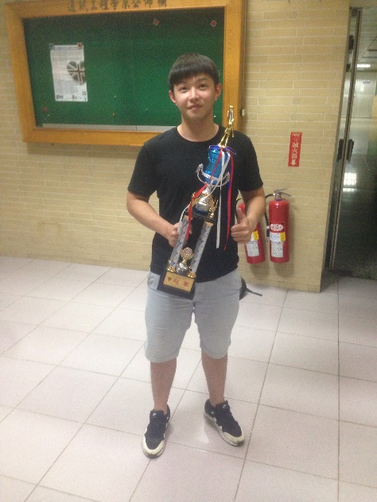
Digital Image Processing HW#1
Instructor: Chih-Wei Tang (唐之瑋)
TA: Ching Huang (黃竫)
Visual Communications Lab
Dep. of Communication Engineering
National Central University
Date: 2017/09/29

Slide 2
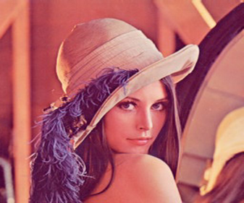

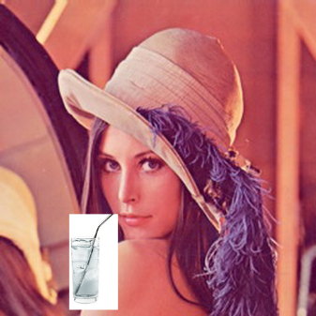
Flow Chart
HW1-1
512*512 and 180*180 24bits bmp
Input Image
Extract header information
Extract pixel information
water圖的中心座標為寬:91 高:91 ,在Lena圖中為寬:151 高:87,water需取78*154(寬*高)
Construct gray-level histogram
Transform to gray-level image
Rotate Lena & covering the local image
1
2
1
2
HW1-2
512*512 8bits
512*512 8bits
512*512 24bits

Slide 3
轉檔方法
用Matlab – imwrite()
input_image=imread(‘water.jpg’);
imwrite(input_image,’water.bmp’,’bmp’);
Photoshop

Slide 4
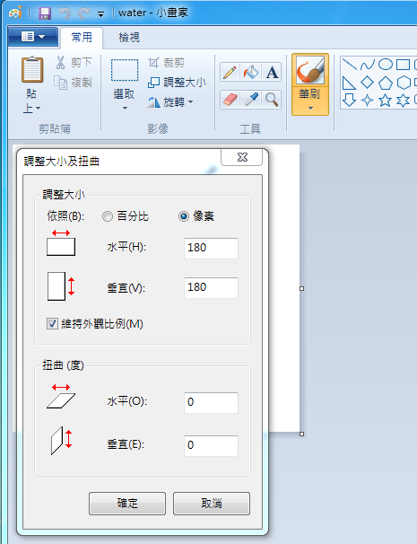
切割方法
將water.bmp用小畫家開啟.
2.
3.

Slide 5
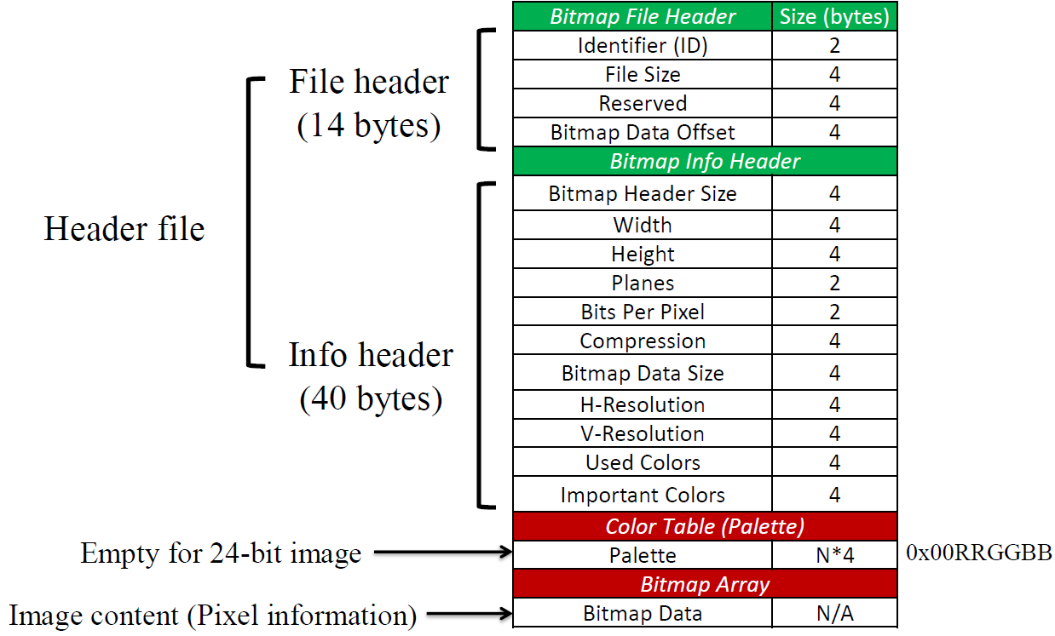
Introduction to Bitmap File(1/2)
http://crazycat1130.pixnet.net/blog/post/1345538#mark-11

Slide 6
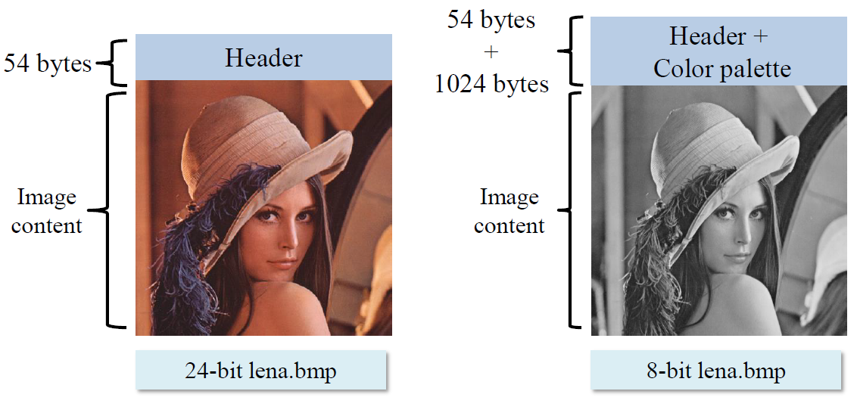
Introduction to Bitmap File(2/2)

Slide 7




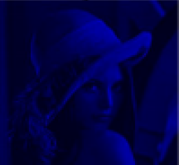
Color Transform
Gray = 0.299*R + 0.587*G + 0.114*B

Slide 8
Construct gray-level histogram
Number of pixels
Gray level
Lena & Water gray
Gray-level histogram
Gonzalez, Rafael C., and Richard E. Woods, “Digital image processing,“ Prentice Hall, 2007

Slide 9
Grading Policy
Code and demo (70%)
Read color image.(10%+10%)
Rotate Lena and covering the local image.(10%+10%)
Color image transform to gray-level image(15%)
(Fig.1: 10% , Fig.2: 5%)
Construct gray-level histogram(15%)
(Fig.1: 10% , Fig.2: 5%)
Report (30%)
Flow chart % experiment results(20%)
Discussions(10%)
Use in C/C++ only. Matlab or OpenCV is not allowed.只有在畫直方圖可以使用Matlab或其它軟體讀取使用C/C++實做完輸出的資料來繪畫直方圖.

Slide 10
Due Date & Demo Schedule
Demo Date: Tuesday Oct.17 or Wednesday Oct.18
Demo time: 14:00 or 18:00 at E1-214-1(@VCLab)
The domo schedule will be announced at the TA webpage.
You should send your project and report to LMS before Oct.17, 13:30.

Slide 11
NOTE
The TA will use another image to test your code.
Do it yourself.
No delay!!!(If you have special case, please send email tell us early.)
You will get a zero in this homework when you delay or fail to operation in demo(code and demo part),but you can still get points in report part.
The details will be announced on our course website.
(http://140.115.154.40/vclab/html/course/DIP2017.html)

Slide 12
Reference
彩色 lena.bmp 載點 http://www.bilsen.com/aic/results.shtml
Water 載點 https://cfshopeetw-a.akamaihd.net/file/ad9791f91bfa67a76e3ececc2df9c9a6_tn
點陣圖(Bitmap)檔案格式 http://crazycat1130.pixnet.net/blog/post/1345538
Gonzalez, Rafael C., and Richard E. Woods, “Digital image processing,“ Prentice Hall, 2007.

